Slide 1
Compartment model to analyze testing strategies and hospitalization capacity scale-up
Vijeta Deshpande
March 28, 2020

Slide 2
Questions
Overlap of definitions of exposed and asymptomatic
Symptomatic but undiagnosed
Recovery
Mortality
Distribution cases
Diagnosed symptomatic and diagnosed asymptomatic
Conversion of diagnosis rate to number of tests, or vice-versa

Slide 3












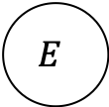


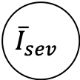





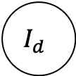




Schematic
$$E$$
$${(R}_{0}⋅0.4)$$
$${(R}_{0}⋅0.4)$$
$$(γ−0.4)$$
$$R$$
$$μ_{d}$$
$$μ_{d}$$
$$R$$
$$r$$
$$I_{shed}$$
$$0.4$$
$$I_{sym}$$
$$r$$
$$d_{E}$$
$$d_{I}$$
$$μ_{d}$$
$$I_{d}$$
$$r$$
$${\overline{μ}}_{mild}$$
$$τ_{mild}$$
$${\overline{r}}_{mild}$$
$${\overline{I}}_{mild}$$
$$τ_{sev}$$
$${\overline{μ}}_{sev}$$
$${\overline{I}}_{sev}$$
$${\overline{r}}_{sev}$$
Death

Slide 4
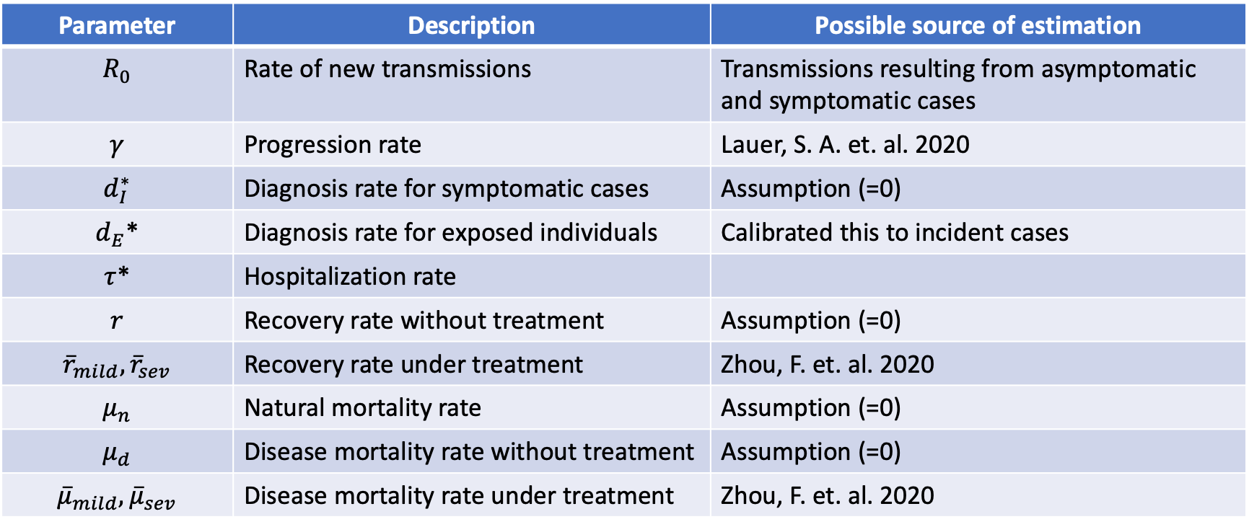
Parameters
Parameter | Description | Possible source of estimation
$$R_{0}$$ | Rate of new transmissions | Transmissions resulting from asymptomatic and symptomatic cases
$$γ$$ | Progression rate | Lauer, S. A. et. al. 2020
$$d_{I}^{∗}$$ | Diagnosis rate for symptomatic cases | Assumption (=0)
$d_{E}$* | Diagnosis rate for exposed individuals | Calibrated this to incident cases
$τ$* | Hospitalization rate
$$r$$ | Recovery rate without treatment | Assumption (=0)
$${\overline{r}}_{mild},{\overline{r}}_{sev}$$ | Recovery rate under treatment | Zhou, F. et. al. 2020
$$μ_{n}$$ | Natural mortality rate | Assumption (=0)
$$μ_{d}$$ | Disease mortality rate without treatment | Assumption (=0)
$${\overline{μ}}_{mild},{\overline{μ}}_{sev}$$ | Disease mortality rate under treatment | Zhou, F. et. al. 2020
*: Probable analysis goals

Slide 5
Calibration model for testing/diagnosis rate

Slide 6

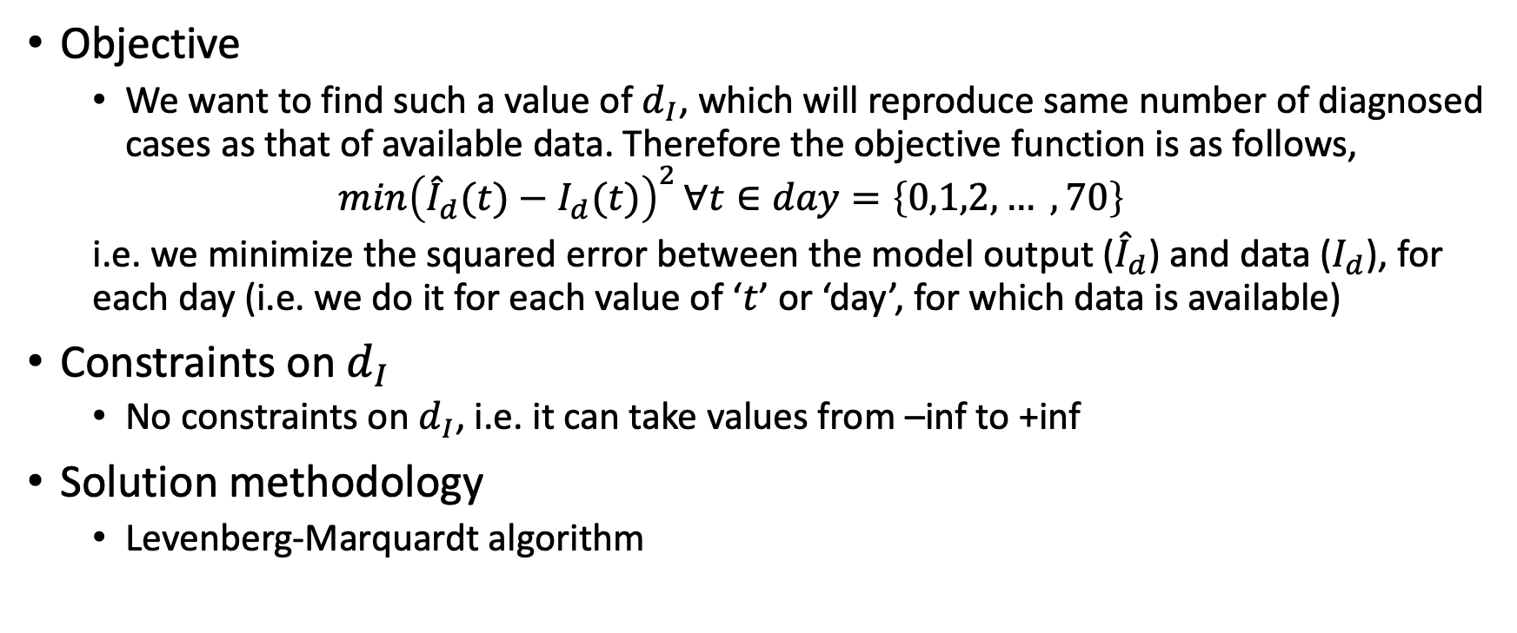
How do we find $d_{I}$?
Objective
We want to find such a value of $d_{I}$, which will reproduce same number of diagnosed cases as that of available data. Therefore the objective function is as follows,
$${\min\left({\hat{I}}_{d}(t)−I_{d}(t)\right)}^{2}∀t∈day=\left\{0,1,2, … ,70\right\}$$
i.e. we minimize the squared error between the model output (${\hat{I}}_{d}$) and data ($I_{d}$), for each day (i.e. we do it for each value of ‘$t$’ or ‘day’, for which data is available)
Constraints on $d_{I}$
No constraints on $d_{I}$, i.e. it can take values from –inf to +inf
Solution methodology
Levenberg-Marquardt algorithm

Slide 7
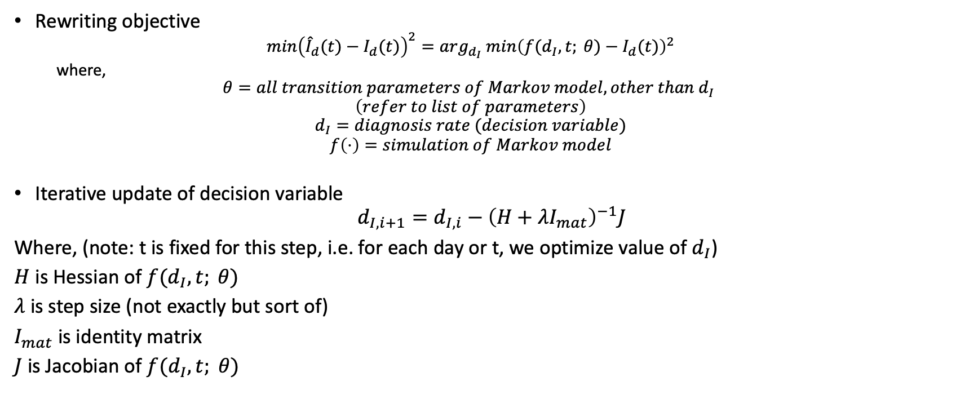
Objective function in terms of our Markov model
Rewriting objective
$${\min\left({\hat{I}}_{d}(t)−I_{d}(t)\right)}^{2}={arg_{d_{I}} min\left(f(d_{I},t; θ)−I_{d}(t)\right)}^{2}$$
where,
$$θ=all transition parameters of Markov model, other than d_{I}$$
$$\left(refer to list of parameters\right)$$
$$d_{I}=diagnosis rate (decision variable)$$
$$f\left(⋅\right)=simulation of Markov model$$
Iterative update of decision variable
$$d_{I,i+1}=d_{I,i}−{\left(H+λI_{mat}\right)}^{−1}J$$
Where, (note: t is fixed for this step, i.e. for each day or t, we optimize value of $d_{I}$)
$H$ is Hessian of $f(d_{I},t; θ)$
$λ$ is step size (not exactly but sort of)
$I_{mat}$ is identity matrix
$J$ is Jacobian of $f(d_{I},t; θ)$

Slide 8
Results of calibration

Slide 9
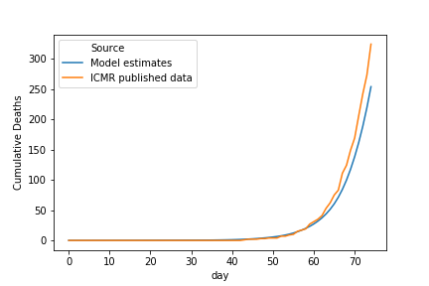
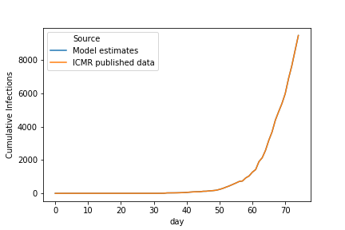
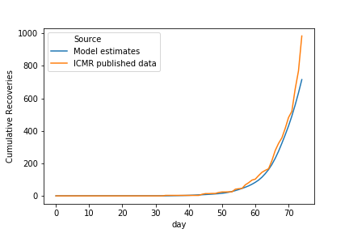
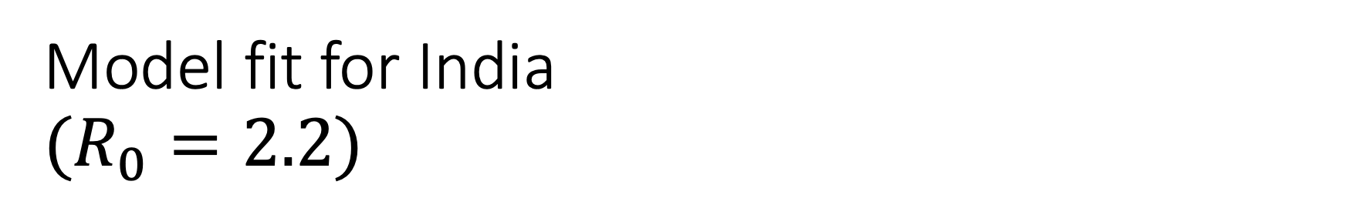
Model fit for India $$(R_{0}=2.2)$$

Slide 10
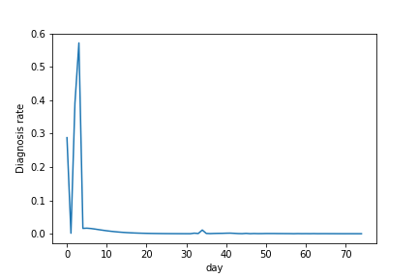
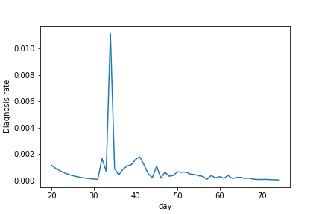
Result for testing/diagnosis rate (India)

Slide 11
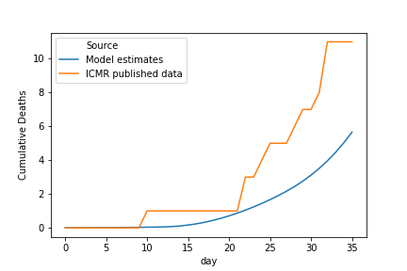
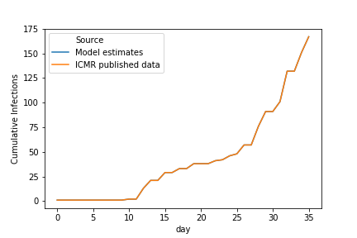
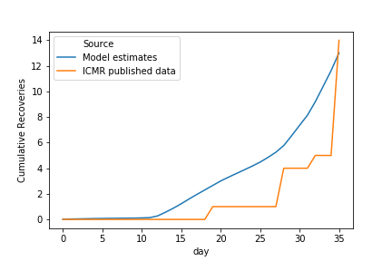
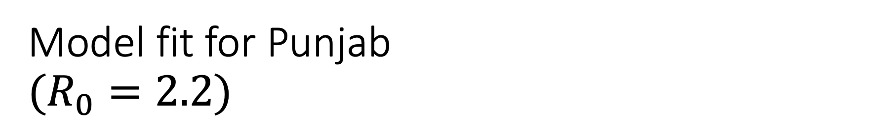
Model fit for Punjab $$(R_{0}=2.2)$$

Slide 12
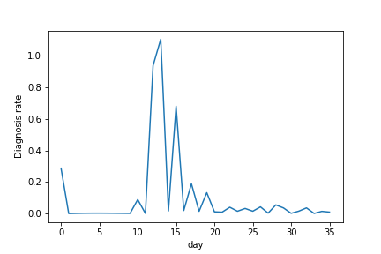
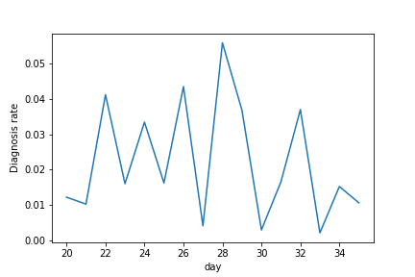
Result for testing/diagnosis rate (Punjab)

Slide 13





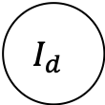
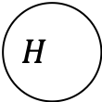








Schematic
$$E$$
$$I_{shed}$$
$$I_{sym}$$
$$I_{d}$$
$$H_{}$$
$$I_{shed}$$
$$I_{sym}$$
$$I_{d}$$
$$H_{}$$

Slide 14
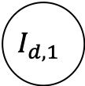



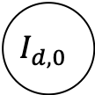
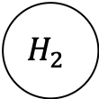

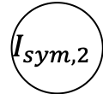
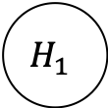
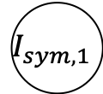

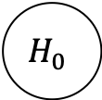
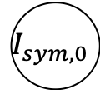
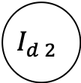
$$Newly diagnosed cases⋅\left(cont. traced\right)⋅(\% of positive results)$$
$$E$$
$$I_{shed}$$
$$I_{sym, 0}$$
$$I_{d, 0}$$
$$H_{0}$$
$$R$$
$$I_{sym,1}$$
$$I_{d,1}$$
$$H_{1}$$
$$I_{sym, 2}$$
$$I_{d 2}$$
$$H_{2}$$

Slide 15






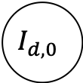
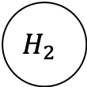


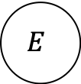


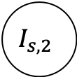
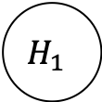

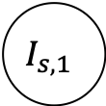





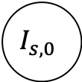




$$d_{0}′$$
$$E$$
$$β−k$$
$$I_{shed}$$
$$k$$
$$I_{s, 0}$$
$$d_{0}$$
$$I_{d, 0}$$
$$h_{0}$$
$$H_{0}$$
$$r_{0}$$
$$R$$
$$γ_{0}$$
$$I_{s,1}$$
$$d_{1}$$
$$I_{d,1}$$
$$h_{1}$$
$$H_{1}$$
$$r_{1}$$
$$θ$$
$$γ_{1}$$
$$I_{s, 2}$$
$$d_{2}$$
$$I_{d 2}$$
$$h_{2}$$
$$H_{2}$$
$$r_{2}$$

Slide 16

Progression rate $(γ)$
Incubation period
Time from onset to first symptom
Ref : Lauer, S. A., Grantz, K. H., Bi, Q., Jones, F. K., Zheng, Q., Meredith, H. R., ... & Lessler, J. (2020). The incubation period of coronavirus disease 2019 (COVID-19) from publicly reported confirmed cases: estimation and application. Annals of internal medicine.
Median incubation period = 5.1 days
97.5% of those who develop symptoms will do so in 11.5 days
101 cases/10,000 will develop symptoms after 14 days

Slide 17
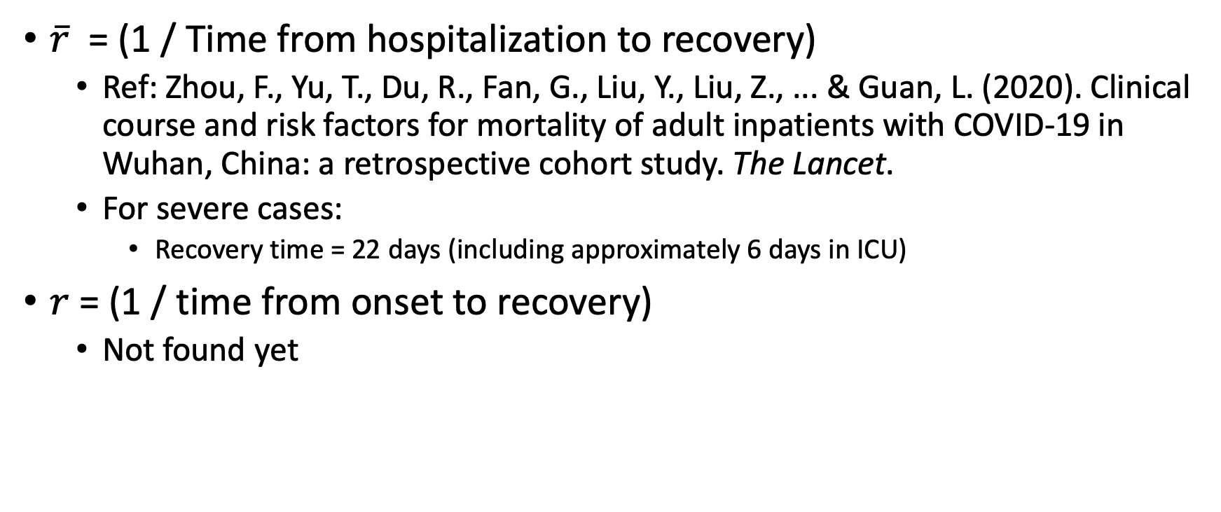

Recovery rate $(r, \overline{r})$
$\overline{r}$ = (1 / Time from hospitalization to recovery)
Ref: Zhou, F., Yu, T., Du, R., Fan, G., Liu, Y., Liu, Z., ... & Guan, L. (2020). Clinical course and risk factors for mortality of adult inpatients with COVID-19 in Wuhan, China: a retrospective cohort study. The Lancet.
For severe cases:
Recovery time = 22 days (including approximately 6 days in ICU)
$r$ = (1 / time from onset to recovery)
Not found yet

Slide 18
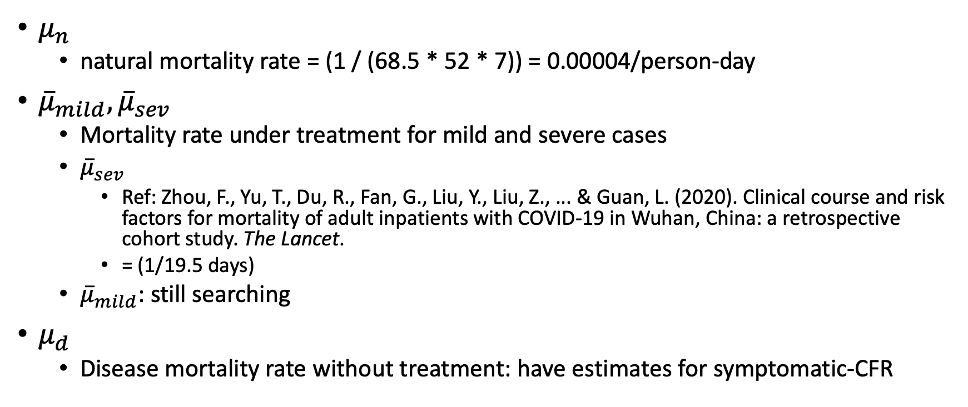

Mortality rate $(μ_{n},μ_{d}, {\overline{μ}}_{mild},{\overline{μ}}_{sev})$
$μ_{n}$
natural mortality rate = (1 / (68.5 * 52 * 7)) = 0.00004/person-day
${\overline{μ}}_{mild},{\overline{μ}}_{sev}$
Mortality rate under treatment for mild and severe cases
${\overline{μ}}_{sev}$
Ref: Zhou, F., Yu, T., Du, R., Fan, G., Liu, Y., Liu, Z., ... & Guan, L. (2020). Clinical course and risk factors for mortality of adult inpatients with COVID-19 in Wuhan, China: a retrospective cohort study. The Lancet.
= (1/19.5 days)
${\overline{μ}}_{mild}$: still searching
$μ_{d}$
Disease mortality rate without treatment: have estimates for symptomatic-CFR

Slide 19
Case fatality rate for symptomatic cases
CFR is (deaths/patients), for our model we want (deaths/person-day)
CFR estimates
Ref: Wu, J. T., Leung, K., Bushman, M., Kishore, N., Niehus, R., de Salazar, P. M., ... & Leung, G. M. (2020). Estimating clinical severity of COVID-19 from the transmission dynamics in Wuhan, China. Nature Medicine, 1-5.
Age | Symptomatic-CFR
<30 | 0.3%
30-59 | 0.5%
>59 | 2.6%

Slide 20
Birth rate for exposed state
Growth in the population of exposed compartment will be due to the transmission generating from exposed and undiagnosed symptomatic cases.
Reproduction rate of COVID19
Ref: Wang, C., Liu, L., Hao, X., Guo, H., Wang, Q., Huang, J., ... & Wei, S. (2020). Evolving Epidemiology and Impact of Non-pharmaceutical Interventions on the Outbreak of Coronavirus Disease 2019 in Wuhan, China. medRxiv.
Social distancing status | Reproductive number
No social distancing | 3.88
Mandatory social distancing | 1.26
Quarantining | 0.32

Slide 21
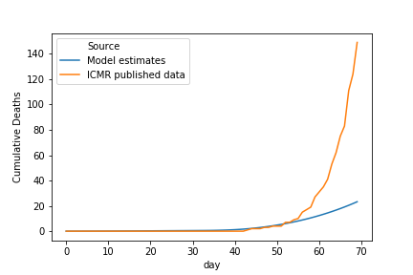
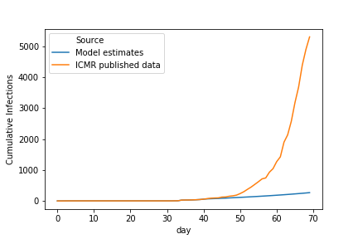
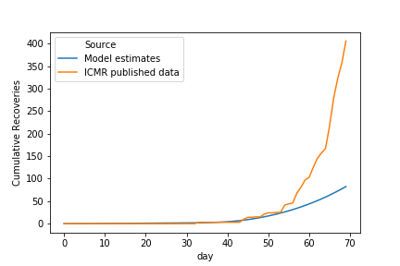

Model fit $(R_{0}=1.2)$

Slide 22
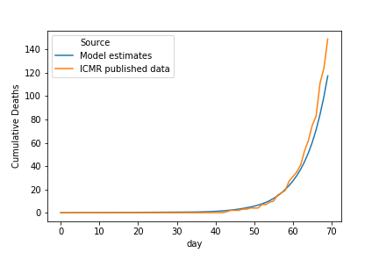
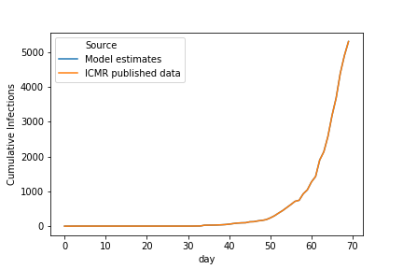
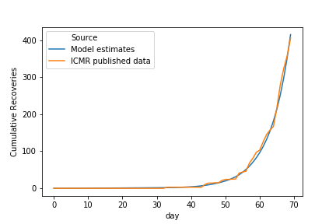

Model fit $(R_{0}=3.2)$

